Slide 1
DenseDiffusion Analysis and Hyper Tuning
By Athulith Paraselli

Slide 2
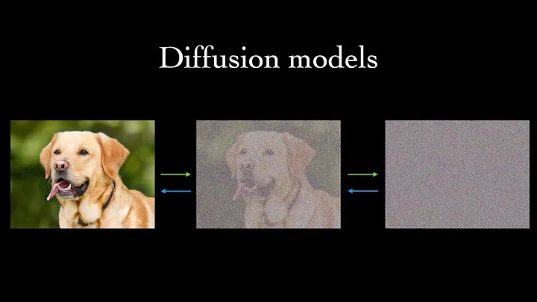
Background - What Are Diffusion Models?
First paper to discuss modern diffusion models was Denoising Diffusion Probabilistic Models by UC Berkeley.
The model starts with observed data and then it adds random noise until it resembles a simple gaussian distribution.
Then the model is trained to iteratively remove the noise until it returns to the original image.

Slide 3
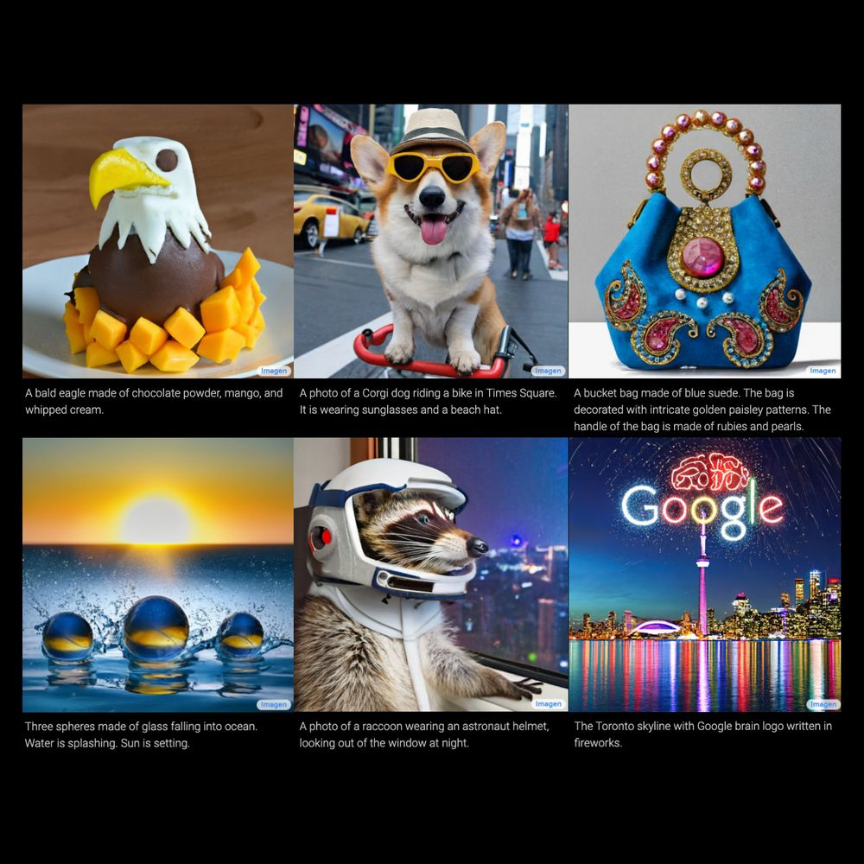
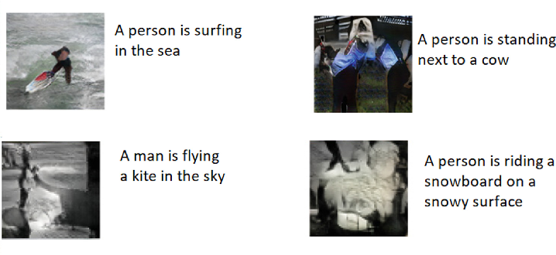
Background - Text-To-Image
Modern models typically have two main steps
Text encoding using models such as transformers or RNNS
Generative step which is done using Diffusion models or GANs
Diffusion offers the benefit of having fine-grained control during generation

Slide 4
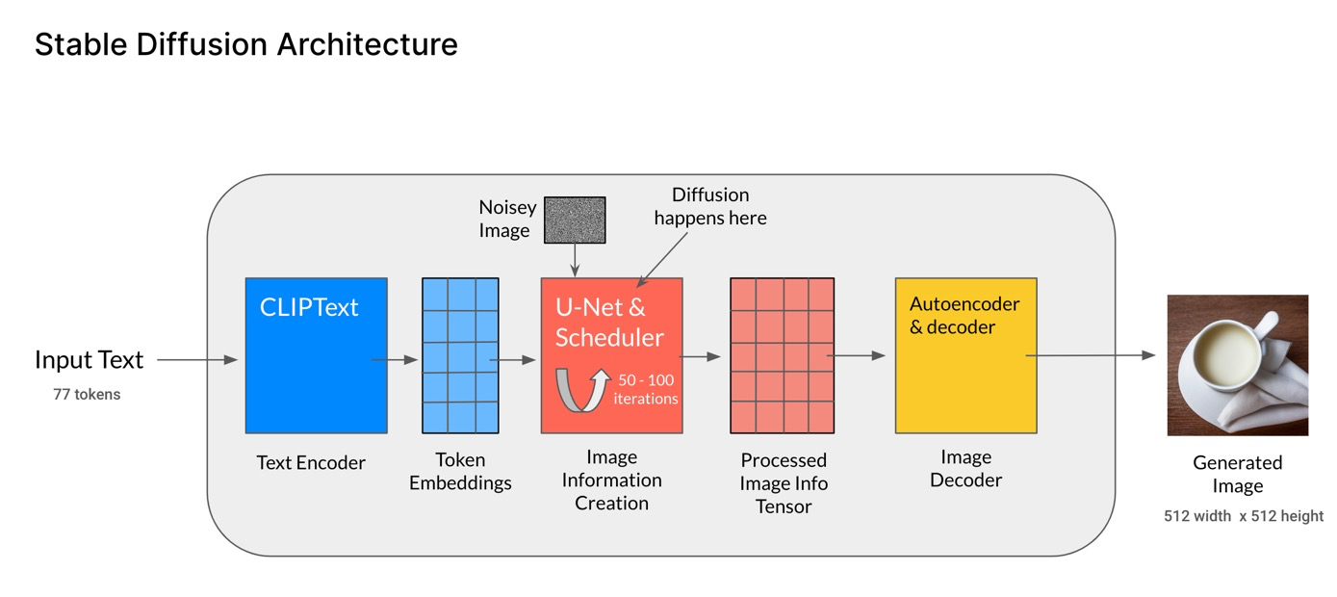
Background - Stable Diffusion
Popular text-to-image model released in 2022
Applies diffusion modeling to the text-to-image frame work

Slide 5
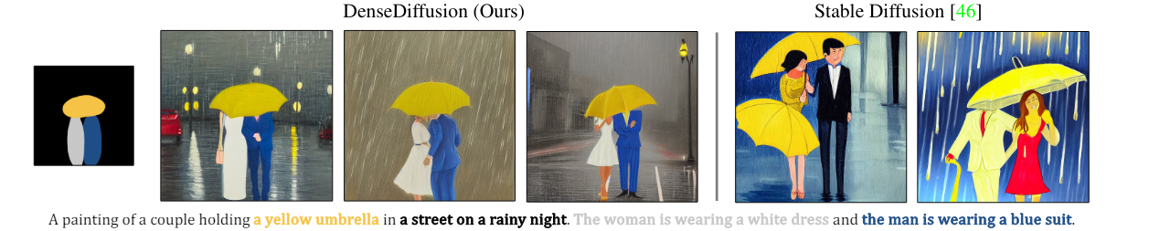
Background - DenseDiffusion
Training free modulator which attempts to improve accuracy when generating images based on dense captions
Modulates attention maps to increase the communication between tokens which refer to the same object

Slide 6
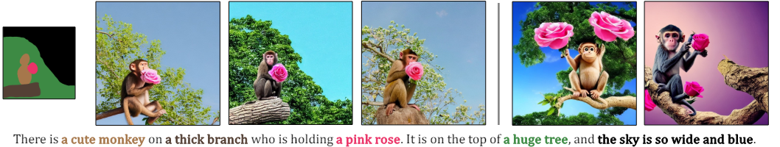
Methods - Model
Using the DenseDiffusion modulation highlighted in the paper
Training and Inference is done using a laptop with a Nvidia RTX 3060M graphics card
The Stable Diffusion model is trained locally on a subsection of the LAION dataset

Slide 7
Methods - Hyper Parameters
DenseDiffusion has three main parameters to modify
W^{c} - The degree of modulation in the cross attention layers
W^{s} - The degree of modulation in the self attention layers
M - adjusts areas of each segment post modulation to make them match better
Attempting to figure out which hyper parameters return the best results

Slide 8
Methods - Evaluation
Three main evaluation methods used / to be used
CLIP Score - Text-To-Image similarity which calculates the similarity between text embedding and image embedding
SOA-I - Object detection approach which checks detects if objects mentioned in text exist in the image
Human preference - ranking based approach where subjects will be asked to rank which images they prefer

Slide 9
Experiment - Format
Baseline hyperparameters are the same as the ones specified in the paper (m=1, wc=1, ws=0.3)
Each of the parameter are modified individually while the other two are kept at the baseline
Clip scores are the calculated and compared/analyzed
Each of the prompts follow the format of:
“Descriptive subject ____ Extra description of subject _____ doing something _____ specific location”

Slide 10
Experiment - Format (Cont)
Broken down into three main rounds
First round is a large search
Tweak m:
m = 0.25
m = 0.5
m = 0.75
Tweak wc :
wc =0.4
wc = 0.8
wc = 1.3
Tweak ws:
ws = 0.1
ws = 0.5
ws = 0.7

Slide 11
Experiment - Format (Cont)
Second round is smaller search dependent on the findings of round one
In this round CLIP score and SOA-I score will be utilized to ensure faithfulness of objects
Third round will make small adjustments and will conduct a human preference experiment to make a final judgement

Slide 12
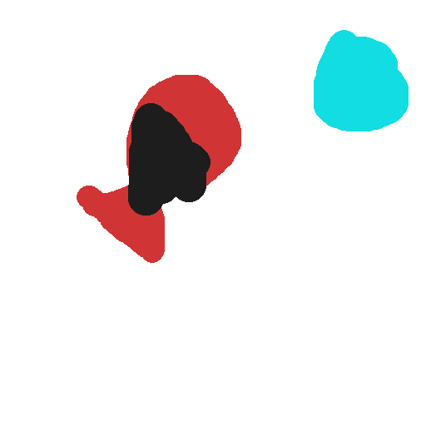
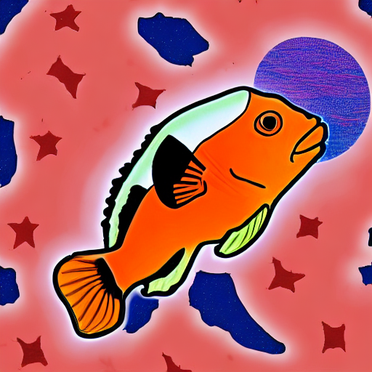
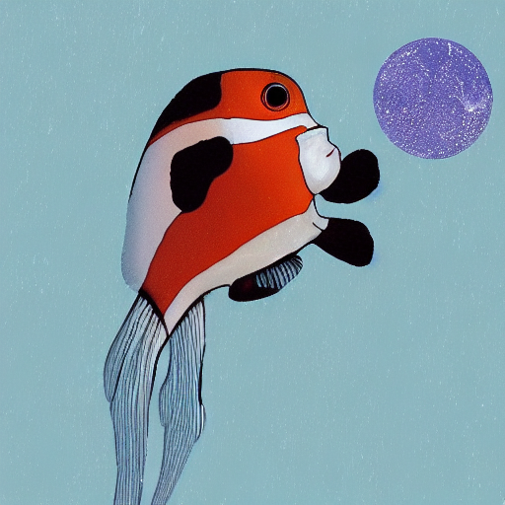
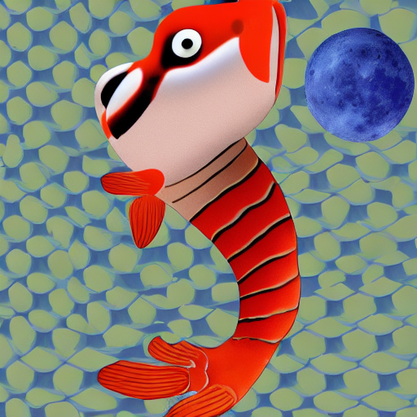
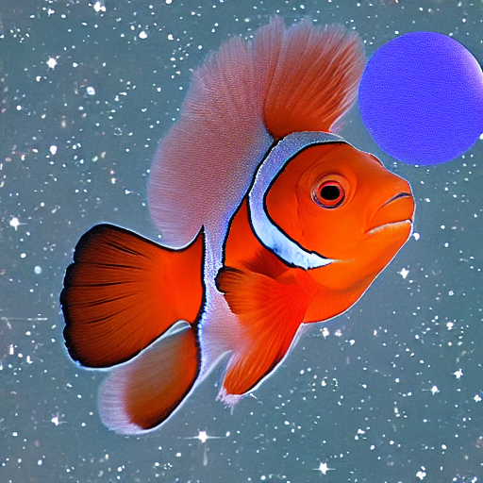
Experiment - Current Results
First round completed
“A red clownfish with a tuxedo jumping towards the blue moon in space”
Baseline
m=0.75
wc = 1.3
ws = 0.7

Slide 13
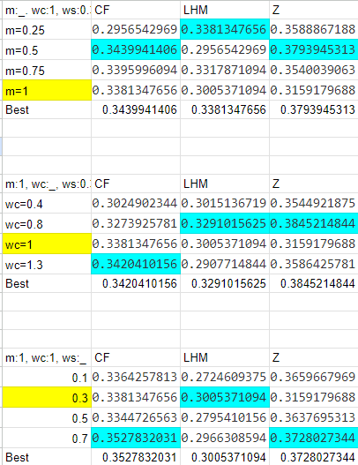
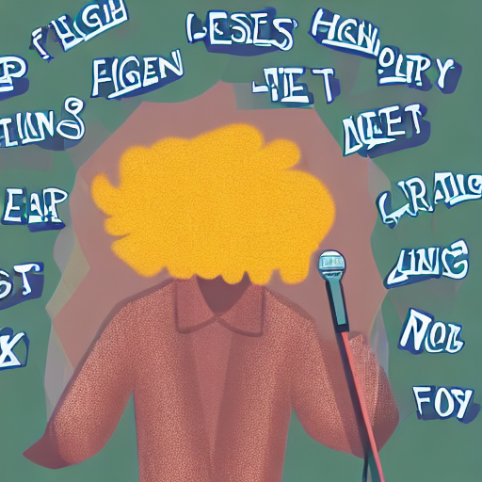
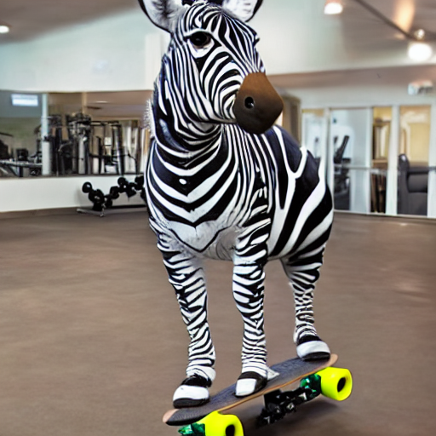
Experiment - Current Results
Other two prompts were:
A man with long hair wearing a jacket singing in a high school classroom
A zebra with wings on a skateboard skating at a commercial gym
As a sanity check, ANOVA was run to shows that parameters likely come from ………………………………………………… different distributions

Slide 14
Experiment - Plans
Second Phase is currently being conducted
For m, testing 0.33 and 0.41
For wc, testing 0.9 and 1.15
For ws testing 0.4 and 0.6
Additionally producing a result with all the best parameters from …………………………………… round 1
Third phase will look into how the hyperparameter interact with ……………………… o . one another

Slide 15
Experiment - Goals
Find the best hyperparameters which work with the generation task
Look for trends between which types of prompts work well with different hyper parameters
Analyze relationships between modulating self attention layers and cross attention layers in order to generalize our results to DenseDiffusion applied to models beyond Stable Diffusion

Slide 16
Limitations
Working with a single laptop GPU
Generating each sample takes about 10-20 minutes
Not enough VRAM to generate two or more samples at the same time
Problems with running SOA - I evaluation
Small sample size due to previous issues mentioned
Small amount of people to ask for image preferences

Slide 17
Further Work
Additional question that have arisen and may have merit for further discussion:
Are there relationships between the inputted text prompts and how well a set of hyperparameters will perform?
Test findings on a larger range of prompts to see if results generalize well
Run same experiment but generate more samples for each test

Slide 18
Conclusion
DenseDiffusion has been found to perform better than stable diffusion when given dense prompts
Adjusting hyperparameters can be tricky because they can lead to lower image quality
Finding a fine balance takes extensive testing and requires heavy analysis
Initial results show a recognizable trends with adjusting each of the hyperparameters
Finding have been taking longer than expected due to time to generate an image

Slide 19
References
https://arxiv.org/pdf/2006.11239
https://arxiv.org/pdf/2211.14305
https://arxiv.org/pdf/2308.12964
https://arxiv.org/abs/2210.08402

